Slide 1

Applied Distributed Systems
Credential Management

Slide 2
Overview
Authentication
Identification factors
LDAP
Single Sign on
Authorization

Slide 3
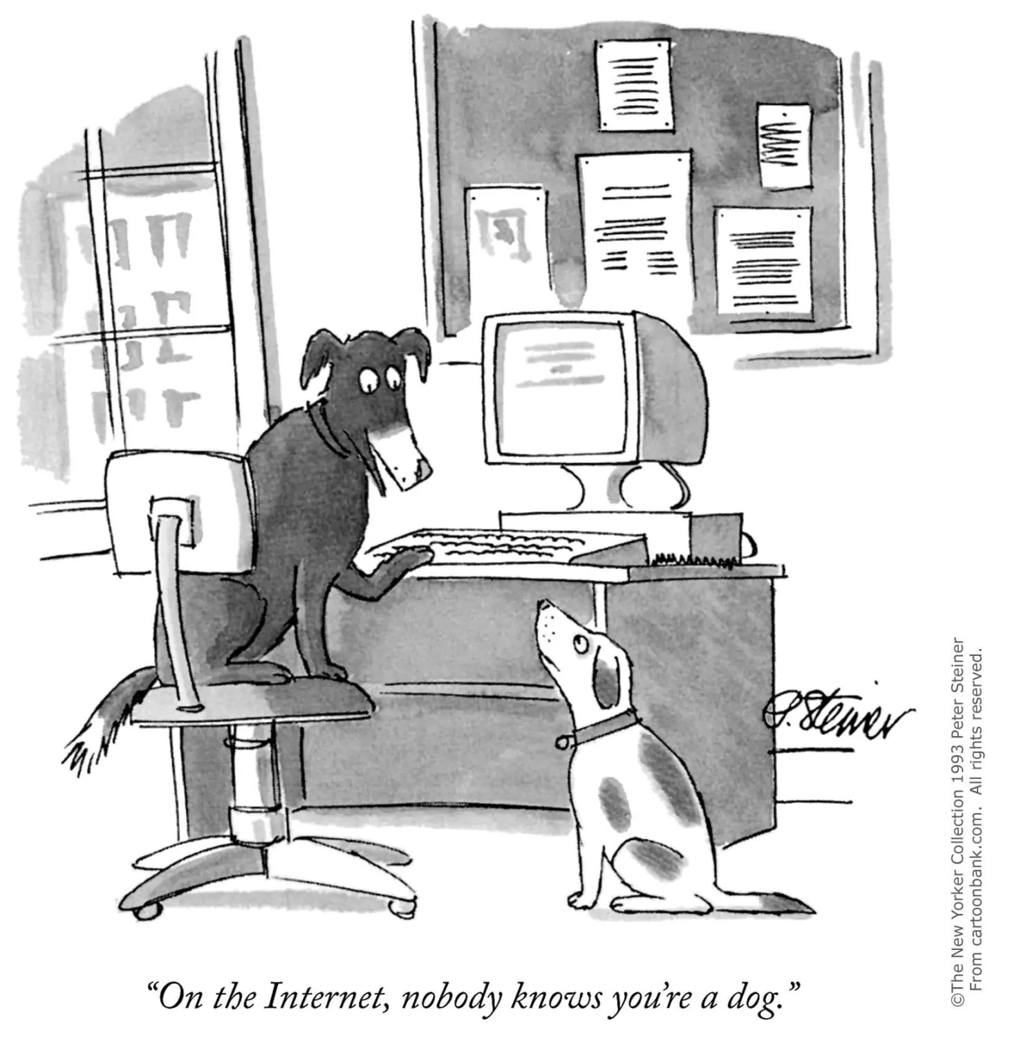
Authentication
Authentication is the act of proving that a user on the internet is who they say they are.
Identification Factors
What you know
What you have
What you are

Slide 4
Identification Factors
What you know
Passwords
Keys
What you have
Smartphone with known number
Smart Card
What you are
Biometrics

Slide 5
Overview
Authentication
Identification factors
LDAP
Single Sign on
Authorization

Slide 6
LDAP
Managing individual accounts and roles within an organization is usually done using Lightweight Directory Access Protocol (LDAP)
Individuals are registered in the LDAP server with account information and roles.

Slide 7
Employee leaves organization
LDAP simplifies managing of computer accounts for individuals joining or leaving an organization
An employee who joins an organization has an LDAP entry created and they then have access to the organization’s computers.
An employee who leaves has their account deleted in the LDAP and they can no longer access the computer systems.

Slide 8
Overview
Authentication
Identification factors
LDAP
Single Sign on
Authorization

Slide 9
Single Sign On (SSO)
Single sign-on (SSO) is an authentication scheme that allows a user to log in with a single ID and password to any of several related, yet independent, software systems.

Slide 10
SSO Protocol
Systems are registered with LDAP
User is registered with LDAP
User signs into one system
System checks with LDAP
LDAP returns authentication token
(Kerbos or SAML)*
Token is returned to user
Subsequent sign ons are performed with token
*Kerberos and Security Assertion Mark Up Language are two different protocols for exchanging authentication information
System 1
.
.
.
User
LDAP
System N

Slide 11
Overview
Authentication
Authorization
RBAC
Credentials for services

Slide 12
Authorization
Authorization is the process of determining whether a user has the privileges to perform a specific function.
Assumes user has been authenticated

Slide 13
Principle of least privilege
Individuals should be given the least privileges they need to do their job
System administrators need different privileges than developers than testers, etc

Slide 14
RBAC
Role Based Access Control (RBAC)
Managing credentials for all of the employees as individuals gets too complicated when there are >500 employees
Define a group of roles and provide credentials based on roles
Assign individuals to one or more roles.

Slide 15
Problems with RBAC
Explosion of roles
Suppose in a bank with multiple branches, one branch gives managers the power to approve loans up to $10,000 and another branch gives managers power to approve loans up to $20,000
Are these two different roles?
Does manager need multiple roles? – including max loan that can be approved.

Slide 16
Credentials are assigned to roles
Suppose individual who leaves has maintenance responsibilities
This allows access to certain rooms via key code.
If key code is changed then remaining maintenance personnel cannot access rooms.

Slide 17
Credential rotation
Credentials can be rotated periodically or upon individual leaving.
Credential rotation is not instantaneous.
An application may have to be designed for alternative credentials.

Slide 18
Overview
Authentication
Authorization
RBAC
Credentials for services

Slide 19
Problem
One service (client) wishes to access a second service
Second service requires credentials.
How does client get credentials?

Slide 20
Solution 1
Configuration management systems have extensions called “vaults”
Vaults maintain information in an encrypted form and require special registrations to access.
Store credential for service in vault
Client retrieves credential from vault
Requires that client be authenticated to configuration management system
Moves problem from service to vault management which can be better controlled by an organization

Slide 21
Solution 2
Use Oauth
Standard
Has four roles:
Resource owner – owns resource
Resource server – controls the resource
Client – wishes to access resource
Authorization server – controls authorization to resource
Frequently combined with SSO

Slide 22
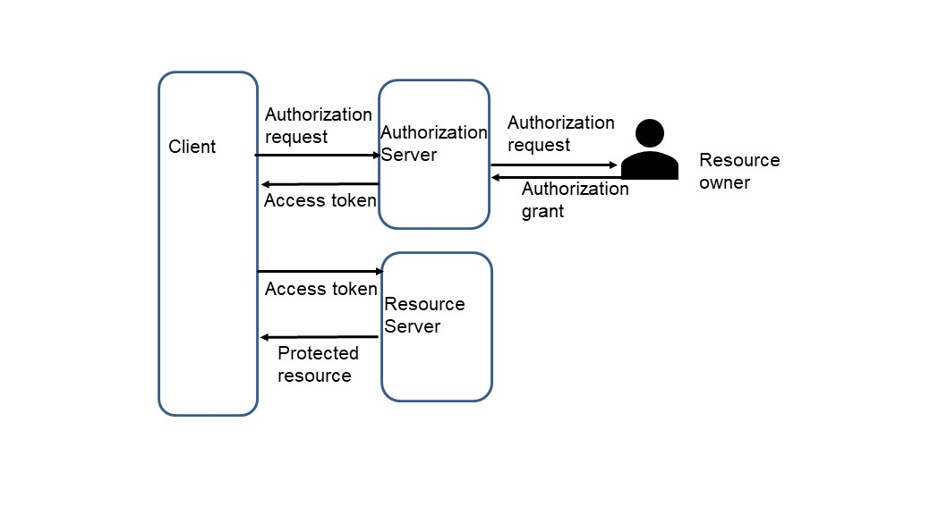
Sample OAuth Protocol

Slide 23
Summary
Single Sign On allows a user to only specify credentials once and gives them access to a set of related systems.
RBAC and LDAP are used to manage credentials and roles for individuals.
Vaults and OAuth are used to control access to services.

